Slide 1
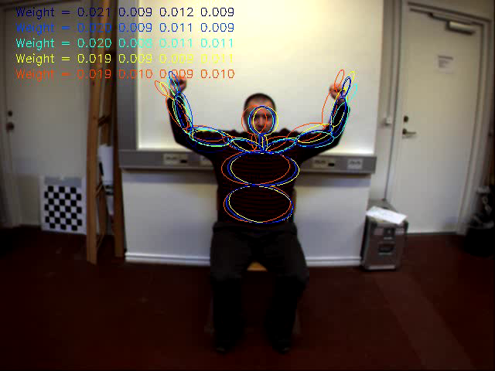
Observations: Region-based texture descriptors
Notes:
Quite simply histograms of gradient orientations
<number>

Slide 2
Observations: Silhouettes
Elgammal & Lee: T-PAMI, 2009

Slide 3
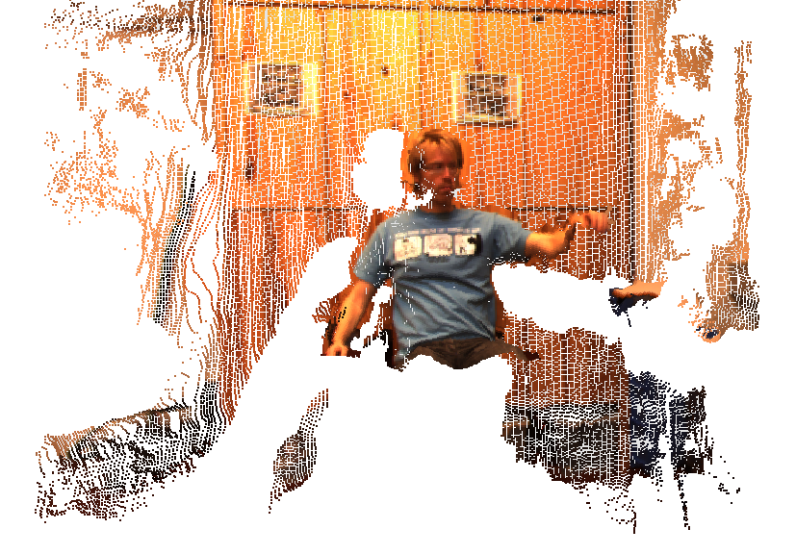
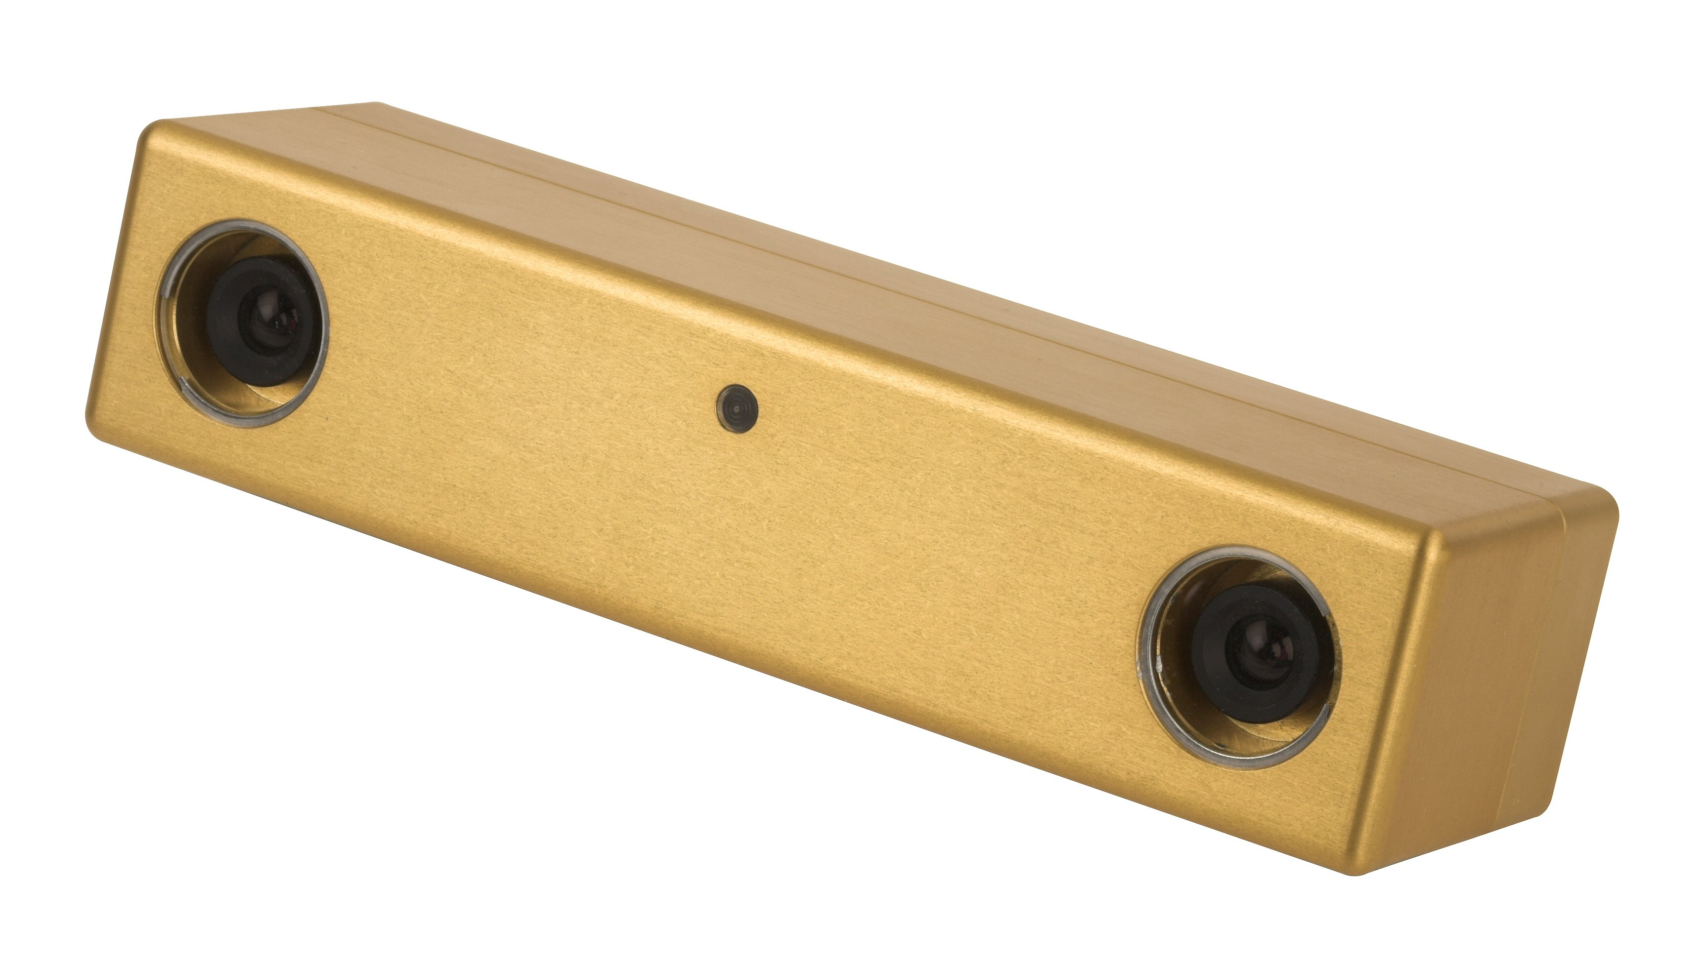
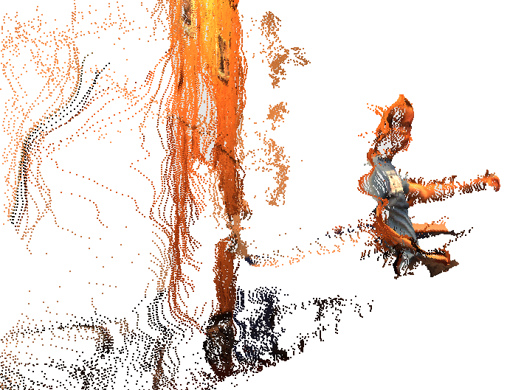
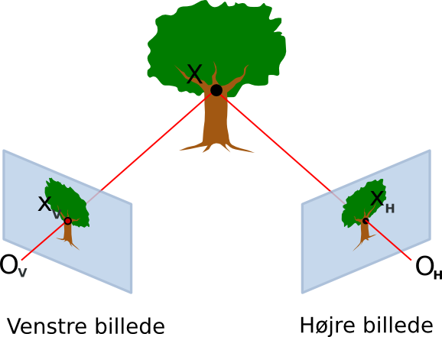
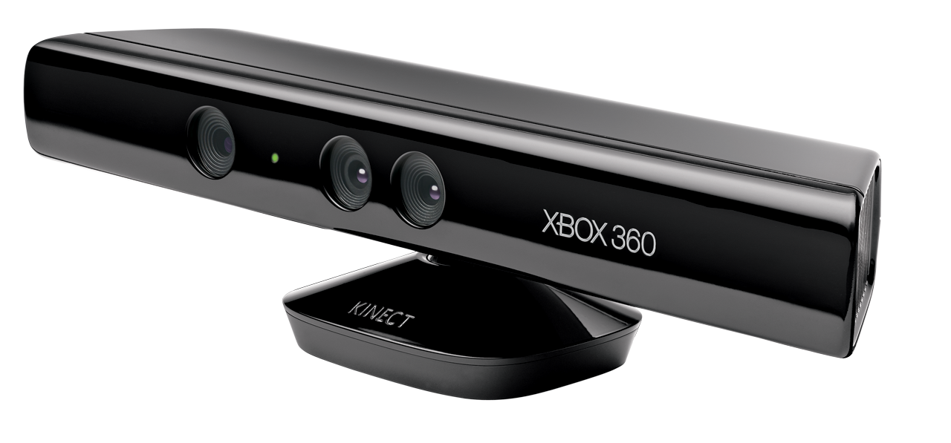
Using dense depth maps as visual observations
Stereo cameras lead to dense depth maps and 3D point clouds.
We use a Point Grey Bumblebee2 stereo camera
MS Kinect sensor
Notes:
From these visual observations we would like to infer the 3D pose of the subject in the video sequence.
<number>

Slide 4
Show live depth map

Slide 5
Human body model (The model-based approach)
The human body is commonly modeled as an articulated collection of rigid limbs connected with joints.
Common representation:
Vector of joint angles together with some representation of global position and orientation.
Geometric shapes for modeling limb surface (boxes, ellipsoids).
Other representations:
Joint positions
End-effector positions
Pure surface models
…
[Hauberg et al, 2009]
Notes:
Joints have different degrees of freedom: Elbow joint has 1 dof, shoulder has 2 dof, etc. Normal full body degrees of freedom D is approx. 30 – 80.
Geometric shapes are used in observation model, and is not really important for us today.
Other representations are possible, but this will do today.
Explain what is meant by end-effector: E.g. Hands, feeds, head.
<number>

Slide 6
Modeling the skin surface
Poppe: CVIU, 2007
Notes:
Examples of models: Boxes, cylinders, capsules, quadrics, polygonal skin mesh
<number>

Slide 7
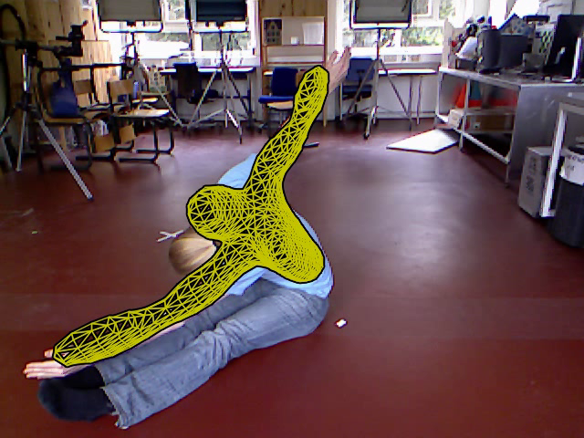
A polygonal mesh skin model in action
Notes:
<number>

